Slide 1
Revolutionizing Stroke Diagnosis: A Highly Accurate and Efficient Machine Learning Model
Harnessing the Power of Data to Identify Patients at Risk of Stroke with incredible results

Slide 2
Project Overview
Problem
Detecting Heart Stroke in patients is difficult using traditional methods. We are solving this by making the detection of stroke in a patient automated/semi-automated using advanced technology by studying the outlining patterns associated with people who are known to have stroke.
Stakeholder
The stakeholders for this case study are Doctors who have the final say & will administer the appropriate drugs basing on the results of the patient.
Data Used
The data we have used to make the models has been got from Kaggle, a large popular website for the Data Science Community.

Slide 3
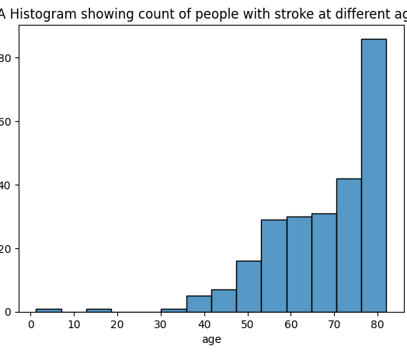
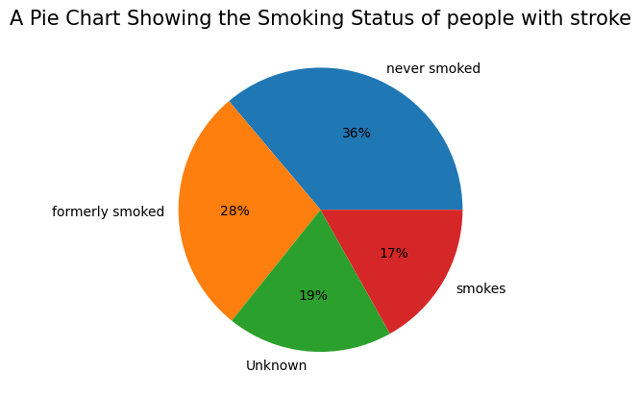
Visualizations that show how some features relate to stroke

Slide 4
Context on How we Shall Identify our Best Model
In order to find the best model that will give us the best results, we need to know how much our model predicts people with stroke & how it predicts people with no stroke.
And to do this, we need to minimize two errors in our data;
False Negative: These are people who actually have stroke, but our model predicts them not to have it. This is a very costly mistake as it can lead to big health problems/death for our patients/customers. We need to minimize this as best as we can.
A metric called recall will help us to keep track of this
False Positives: These are people who don’t have stroke, but our model predicts them to have it. This might mean extra costs for our patient, but we are OK with it.
A metric called precision will help us to keep track of this
Limitations/Weaknesses of our dataset;
Our original dataset was very imbalanced as it had more than 95% of the patients not having stroke.
We have put this into consideration and over sampled the positive class in order to create some balance & reduce bias before modeling. These massively improved our results

Slide 5
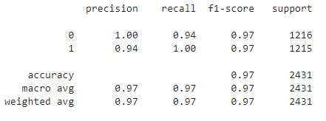
RESULTS
Our model has a recall of 100% for the positive class meaning that it can predict 100% of the time the people with stroke.
Our model also has a precision of 100% for the negative class meaning that it can predict 100% of the time people who don’t have stroke
The model has an f1-score of 97% meaning it can predict good in both precision & recall
Our model has an overall accuracy of 97% indicating great overall performance.

Slide 6
Final Recommendations
It’s time we deploy this model in the Real World and start using it on unseen data.
Even though this model makes amazing predictions, we still have to improve our work by;
Collecting more data points for people with stroke so that we can reduce bias in our next iteration of modeling.
Create better balance in our target column to make better predictions
Finally, it’s time we put this work into use in the Real World and start making predictions on unseen data. I’m super Excited about that.

Slide 7
Q & A

